Slide 1


Slide 2

Major Project – II (01CE0807)
Review 2 (02/03/2024)
Learn Sync – Your Learning Companion
Team ID: MU_CE_2023-24_126
Team Member 1: Aum Pitroda (92000103148) (TC3)
Team Member 2: Ravi Ajagiya (92000103139) (TC2)
Team Member 3: Kishan Songara (92000103090) (TC2)
Guided By
Internal Guide Name: Prof. Santushti Betgeri
Department of Computer Engineering, Faculty of Technology

Slide 3
Outline
Introduction to Project and Project Management
Project Summary
Motivation
Objective
Scope
Technology & Literature Review
Project Planning
Gantt Chart
Roles & Responsibilities
System Analysis
Study of Current System
Features of LearnSync
Components of LearnSync
System Design
System Design & Methodology
Database Design
User Flow Diagram
Conclusion
References

Slide 4

Introduction to Learn Sync
Our Team’s Moto :
Be Precise, on time, just meaningful!

Slide 5

Introduction to Learn Sync
LearnSync: Revolutionizing learning with
Advanced Techniques
Gamified Journeys
All-in-one hub
Connected Community
for excellence…

Slide 6

Motivation Behind LearnSync
In the exam's embrace, challenges dance, testing resilience's elegant stance.
Vast Syllabus
Time-Bound Revision
Motivation Hurdles

Slide 7

Objectives of LearnSync
Fully Functional Web App: Deliver LearnSync, a feature-rich web app, ensuring all aspects function flawlessly and pass rigorous testing.
Scalable Database Infrastructure: Optimize MongoDB for efficient performance, handling user data, tasks, groups, and activities with scalability in mind.
User-Friendly Interface: Design an intuitive interface with smooth navigation, ensuring a satisfying and engaging user experience.
Integration with External APIs: Seamlessly integrate LearnSync with external APIs like Google Calendar & Email, enhancing connectivity and overall functionality.
Comprehensive Documentation: Provide detailed codebase documentation and user training materials, empowering users to efficiently utilize LearnSync's benefits.

Slide 8
Objectives of LearnSync
Supporting Aspirants: Equip aspirants to conquer competitive exams, overcoming challenges with Learn Sync's innovative approach.
UI Excellence: Craft a sleek UI for Learn Sync, balancing aesthetics and utility seamlessly for user satisfaction.
Cost-Free Advantage: Provide Learn Sync as a cost-free gem, standing against market competitors, making learning accessible to all.
Accessible, Usable, Scalable: Design Learn Sync for easy access, usability, and scalable adaptability, meeting diverse learning needs effortlessly.
Streak-Based Motivation: Introduce Learn Sync's streak-based approach, turning challenges into achievements, fueling continuous motivation for users.

Slide 9

Scope of LearnSync
Optimize Learning Schedules: Efficiently plan studies with Spaced Repetition, Task, and Time Schedulers.
Enhance Focus with Pomodoro Timer: Boost productivity using Pomodoro Timer for focused study intervals.
Motivate Through Streaks: Instill motivation with Task Streaks, fostering a consistent learning rhythm.
Build Collaborative Communities: Foster connections through Friend's Activity Panel, Group Streaks, and Leaderboards.
Organize Information with Flash Cards: Facilitate effective learning through Flash Cards, promoting information retention.

Slide 10
Literature Survey
Calendly.com: Streamlined scheduling tool; inspiration for efficient task management in LearnSync.
Google Keep: Note-taking simplicity; influence on intuitive task organization in LearnSync.
AnkiNotes: Spaced repetition pioneer; guides memory optimization in LearnSync's scheduler.
Pomofocus.io: Pomodoro technique integration; inspiration for time management in LearnSync.
Unacademy: E-learning platform; motivates LearnSync's educational focus and community engagement.
Snapchat: Social interaction model; influences LearnSync's collaborative features and engagement

Slide 11

Project Planning for LearnSync – Agile Methodology
Agile Scrum is a flexible project management framework emphasizing collaboration, iterative progress in short sprints, and continuous improvement, providing adaptability for changing requirements and efficient team communication.
Why Agile -> SCRUM? Scrum is ideal for LearnSync's small team of three, ensuring clear roles, close collaboration, and efficient task distribution.
Sprint | Start Date | End Date | Goals/Tasks
Sprint 1 | 13/01/2024 | 26/01/2024 | UI Design
Sprint 2 | 27/01/2024 | 09/02/2024 | Backend Functions
Sprint 3 | 10/02/2024 | 23/02/2024 | Database & API Integration
Sprint 4 | 24/02/2024 | 02/03/2024 | Refinements on API’s & Additional Features
Sprint 5 | 03/03/2024 | 26/04/2024 | Refinements & Documentation

Slide 12
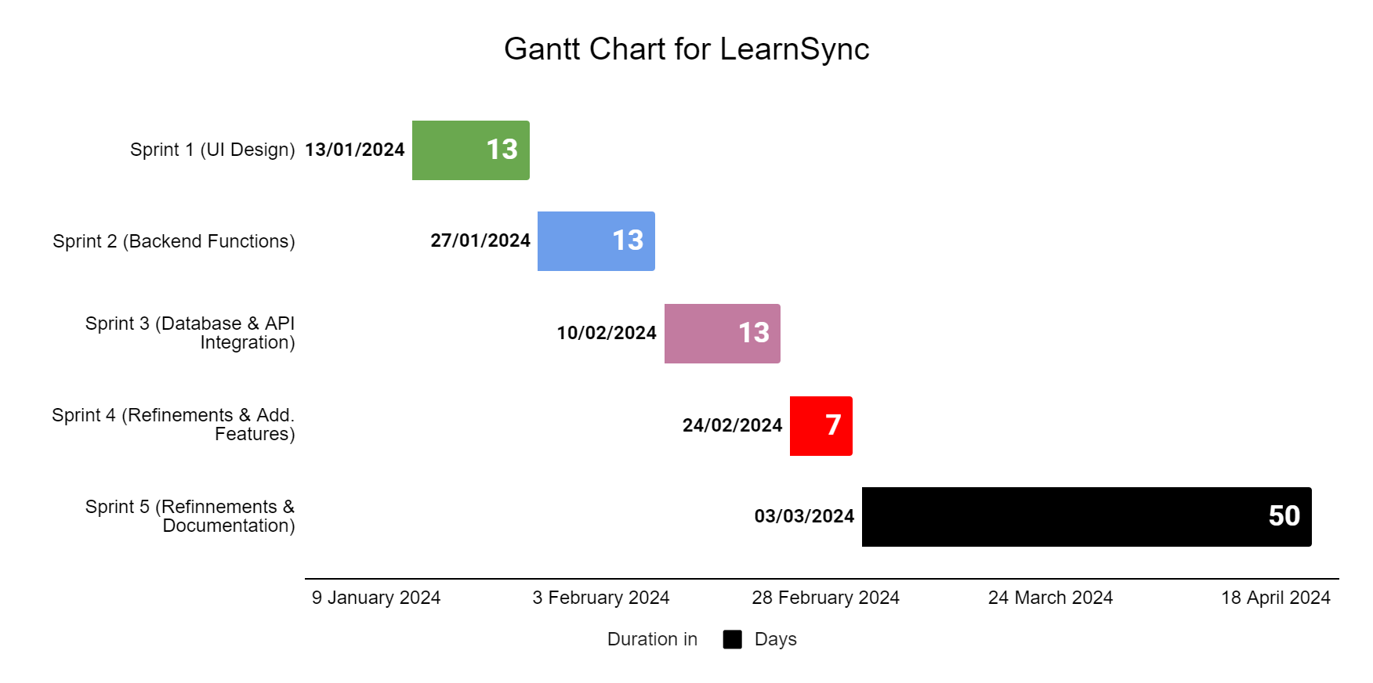
Gantt Chart for LearnSync

Slide 13

Roles & Responsibilities of Team Members
Om: UI Developer
Primary Responsibility: Develop the user interface for LearnSync's web application.
Tasks:
Design visually appealing and intuitive user interfaces.
Implement responsive and user-friendly web pages.
Collaborate with other team members for a cohesive design.
Ravi: Backend Developer (Flask)
Primary Responsibility: Implement classes and functions for the Flask backend of LearnSync.
Tasks:
Model and code backend functionalities according to project requirements.
Ensure integration of backend components for seamless functionality.
Collaborate with UI developer for front-back integration.
Kishan: Quality Assurance Engineer
Primary Responsibility: Test both UI and backend for integration and utility.
Tasks:
Develop and execute test plans for the web application.
Identify and report bugs, ensuring a smooth and error-free user experience.
Collaborate with UI and backend developers for issue resolution.

Slide 14
Study of Current Systems their Major Problems & Weaknesses and Requirements of New System
Fragmentation hampers seamless learning, requiring navigation across multiple scattered tools.
Unified Platform: Integrate various tools into a cohesive, unified learning platform.
Gamification lacks immersion, missing opportunities for a motivating learning experience.
Immersive Gamification: Implement engaging and motivating gamification for a truly immersive experience.
Overlooked techniques like spaced repetition limit memory retention enhancement .
Comprehensive Techniques: Prioritize memory enhancement techniques in to design.
Social platforms lack the warmth of a real community for learning.
Vibrant Community Integration: Foster a warm and vibrant community atmosphere for collaborative learning.
Some tools suffer from unfriendly user interfaces, hindering the learning journey.
Sleek User Interface: Design a modern and user-friendly interface for a smooth learning journey.

Slide 15
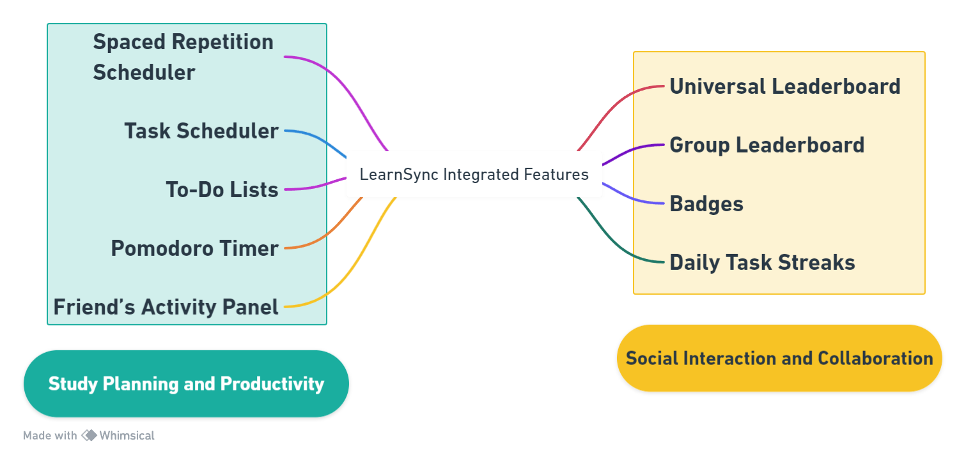
Features of LearnSync : Activities + Easy Integration with Native Tools

Slide 16
Components of LearnSync (Overview of Modules / Pages)
Introduction & Support | User Interactions | Social Interaction | User Account
Home/Welcome Page | Dashboard | Friend's Activity Panel | Profile
Login/Registration | Modules Accessible on Dashboard Study Planning Spaced Repetition Scheduler Task Scheduler To-Do Lists Pomodoro Timer Links to Other Pages | Domain Leaderboard | Integration
About Us | Spaced Repetition ... | Group Leaderboard | Leaderboard
FAQs | Task Scheduler | Badges | Streaks and Challenges
Privacy Policy | To-Do Lists | Daily Tasks Streaks | Settings
 | Pomodoro Timer | Group + Task Streaks | Error Pages

Slide 17
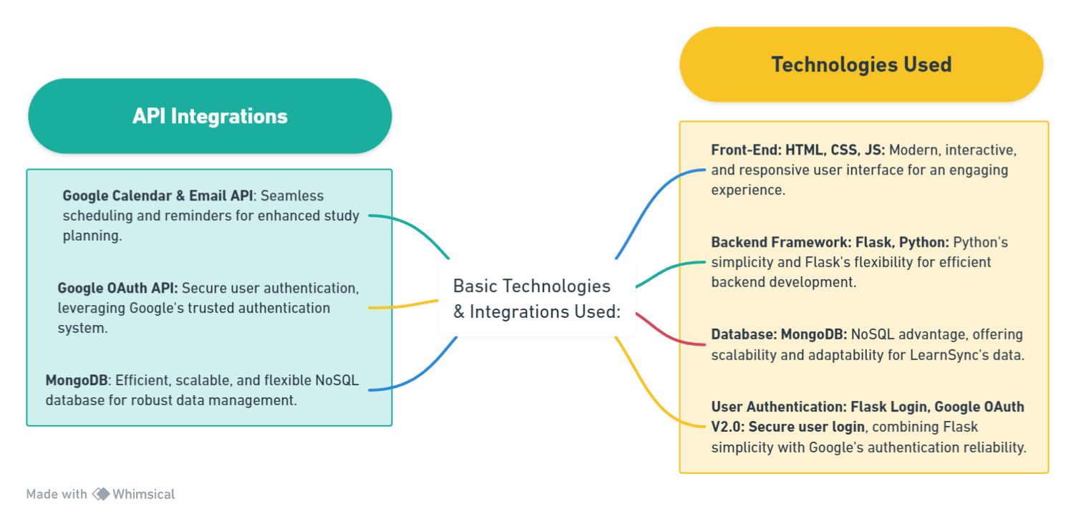
System Design for Web Based App : Tools Used

Slide 18
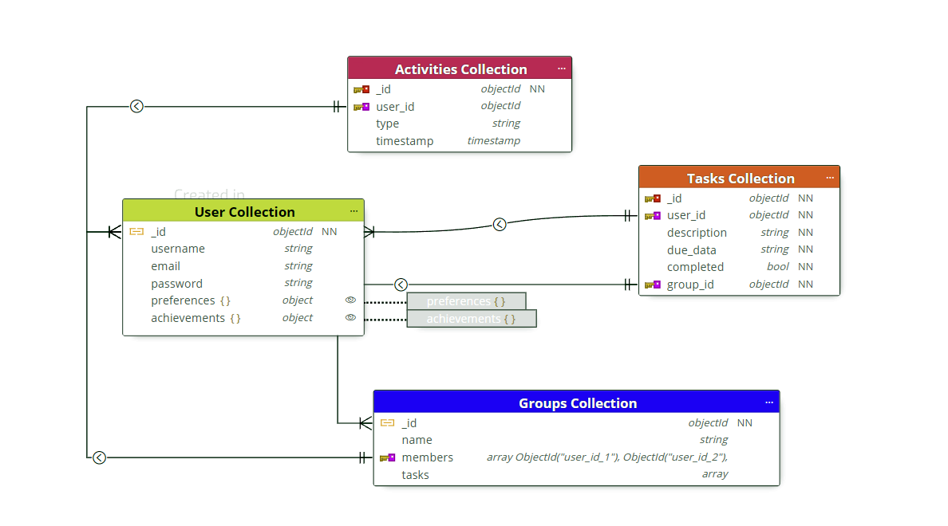

No-SQL Database : MongoDB Design For LearnSync

Slide 19
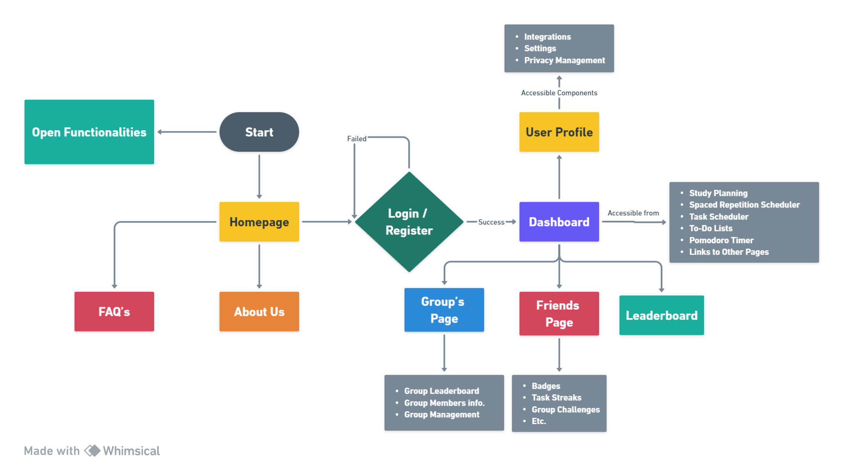
User Flow Diagram for LearnSync Basic

Slide 20
Introduction to Learn Sync
LearnSync: Revolutionizing learning with advanced techniques, gamified journeys, all-in-one hub, and a connected community for excellence.

Slide 21
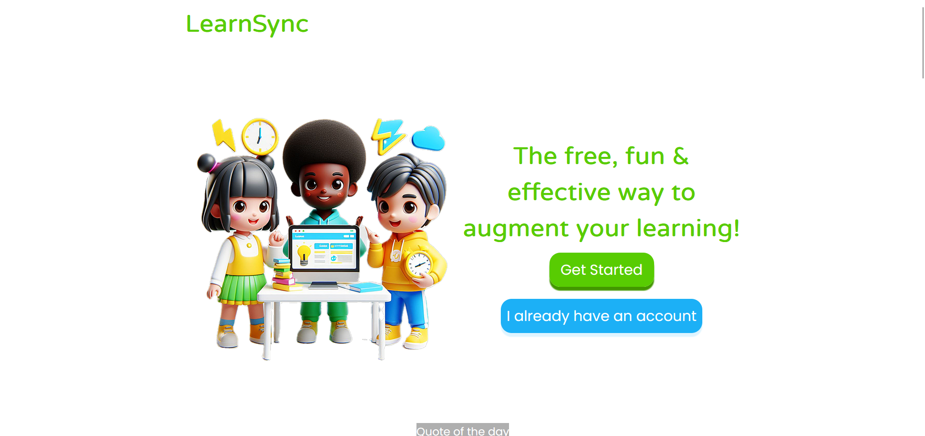
Implementation
Home page

Slide 22
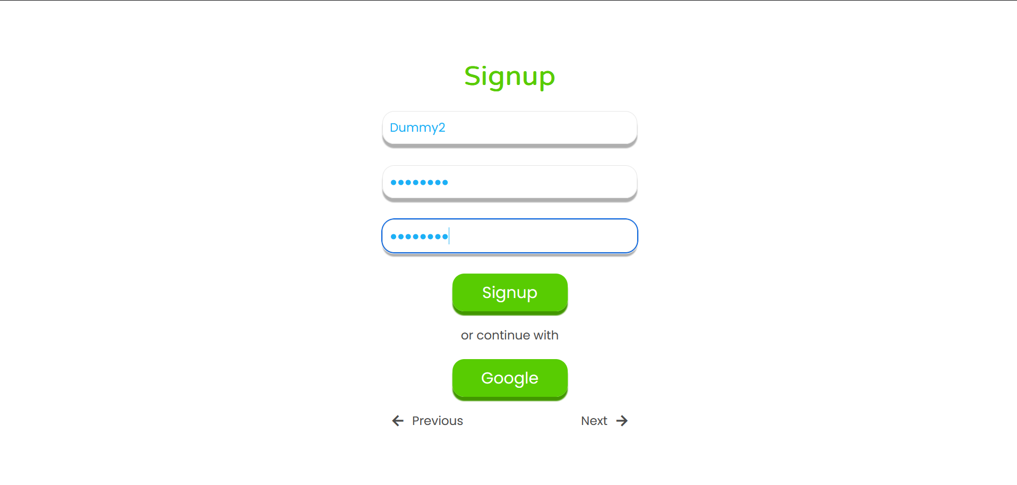
Implementation
Sign-up page

Slide 23
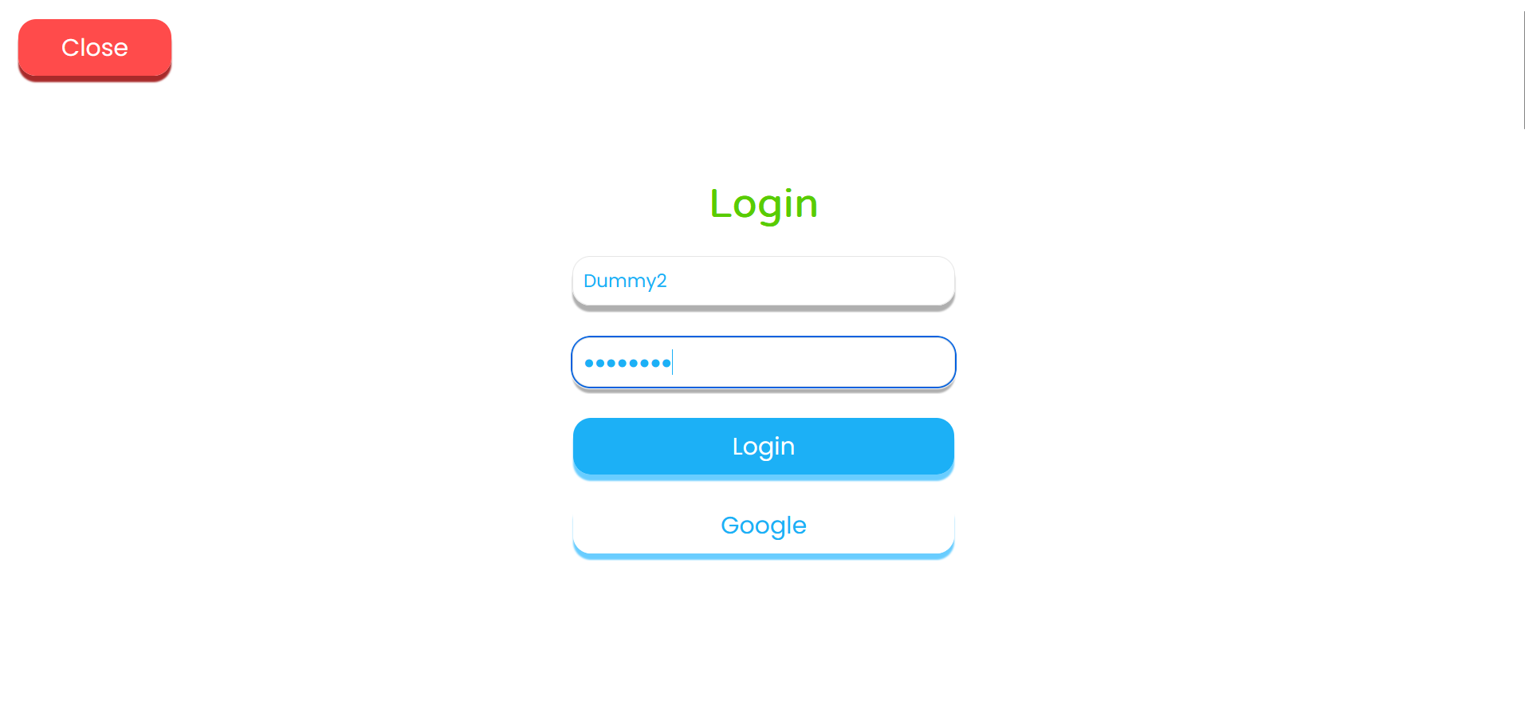
Implementation
Login page

Slide 24
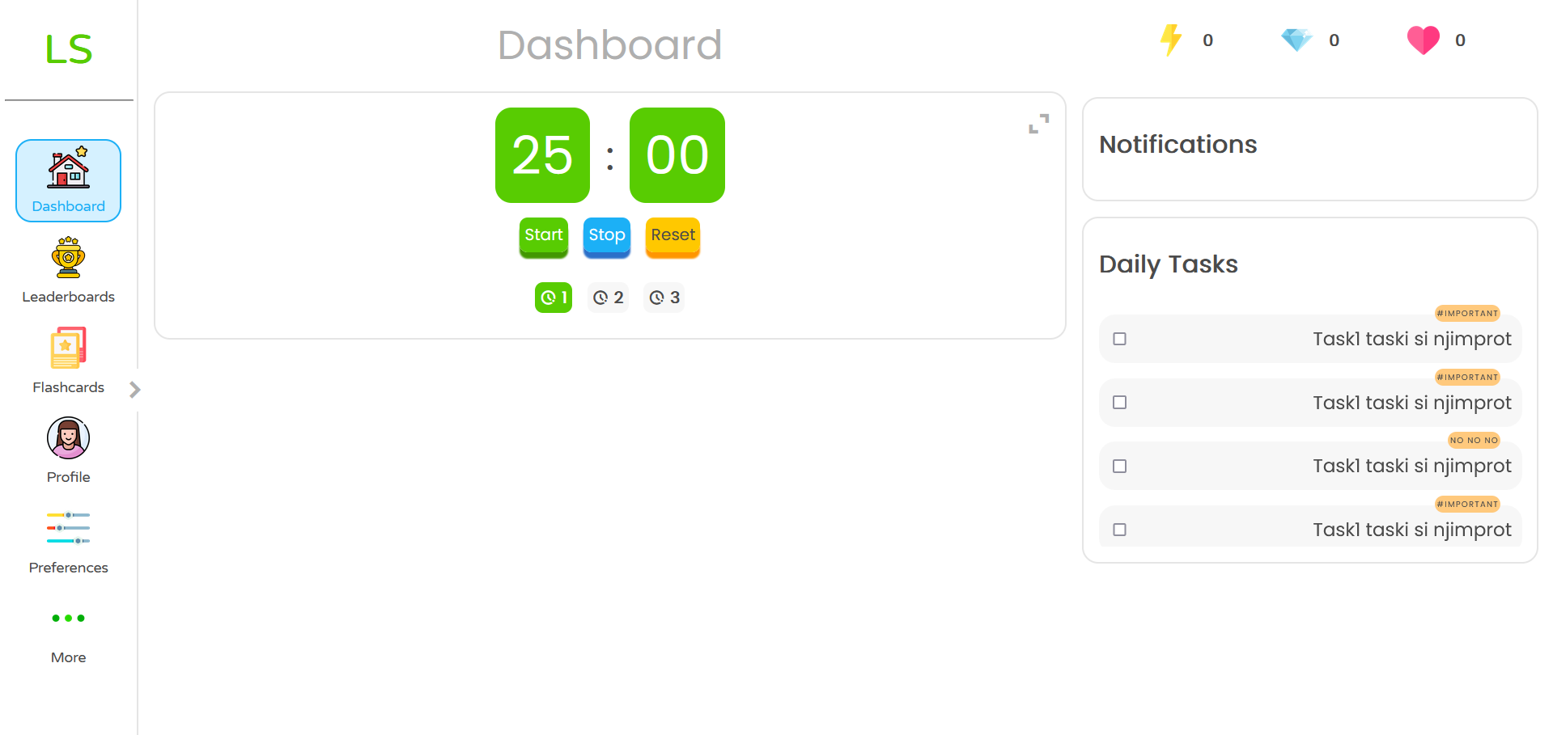
Implementation
Dashboard page (Pomodoro Timer )

Slide 25
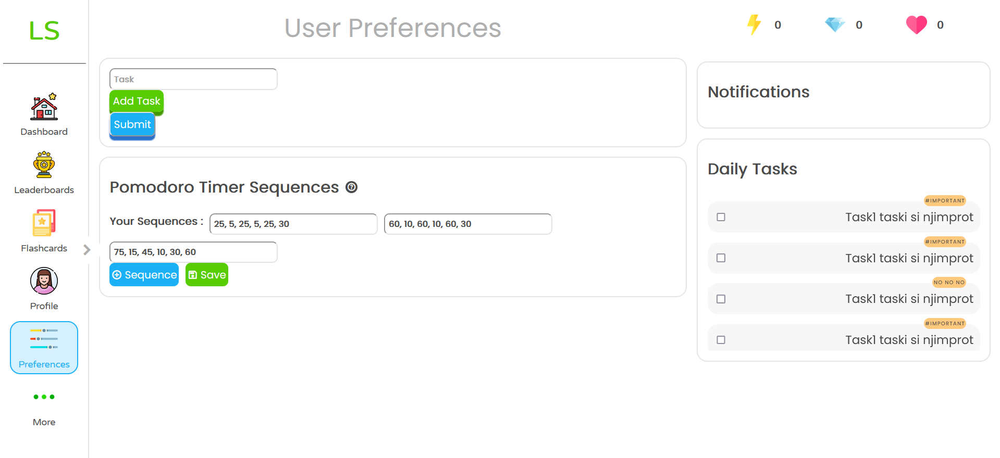
Implementation
User Preferences

Slide 26
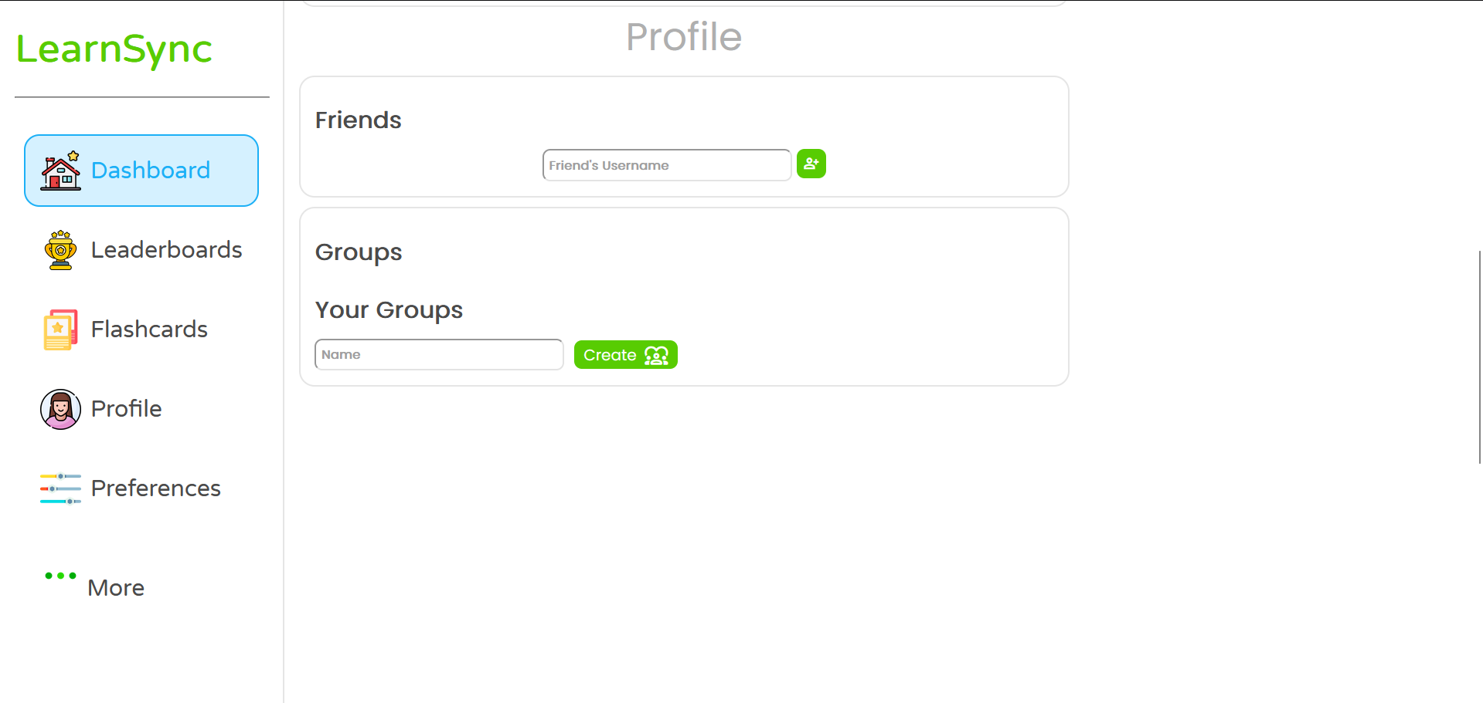
Implementation
Dashboard page continue..

Slide 27
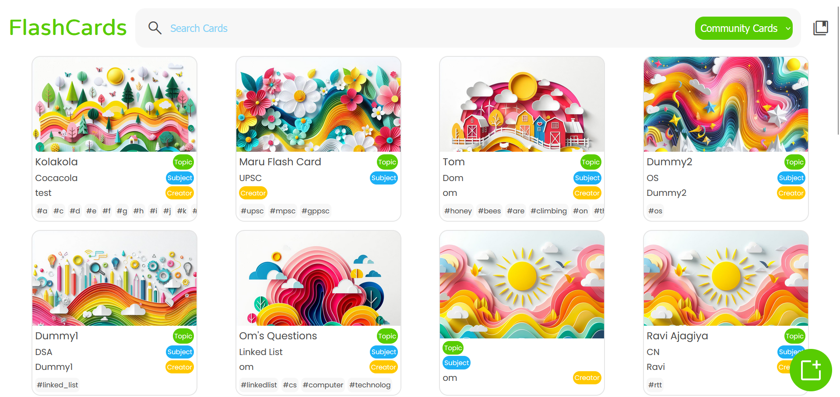
Implementation
Flashcards

Slide 28
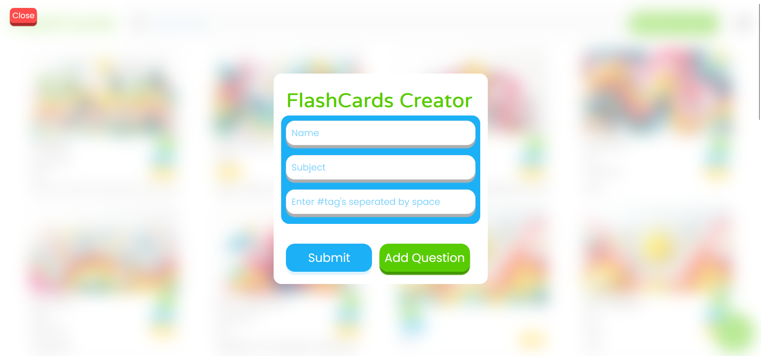
Implementation
Creation of a Flashcard

Slide 29
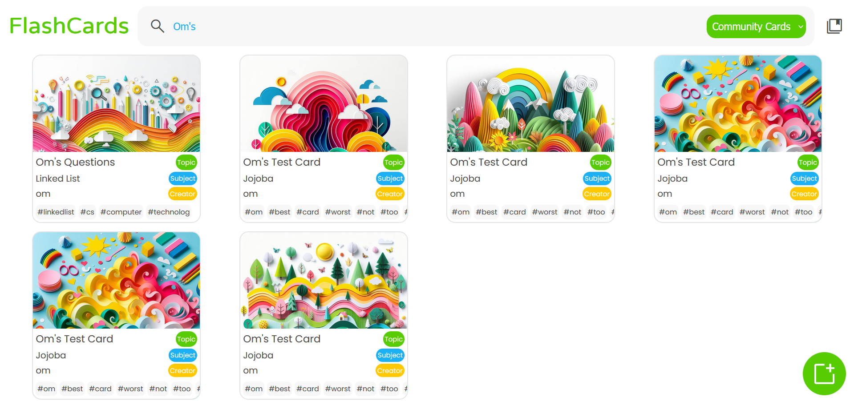
Implementation
Search option in Flashcard

Slide 30
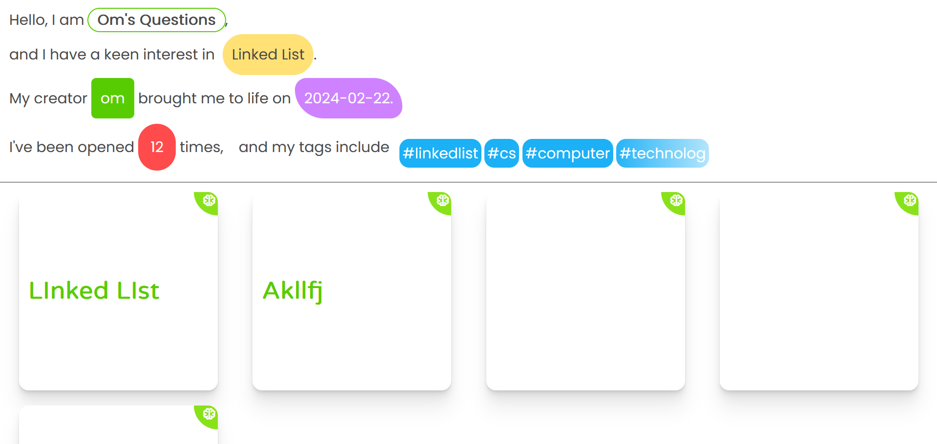
Implementation
Inside particular Flashcard

Slide 31
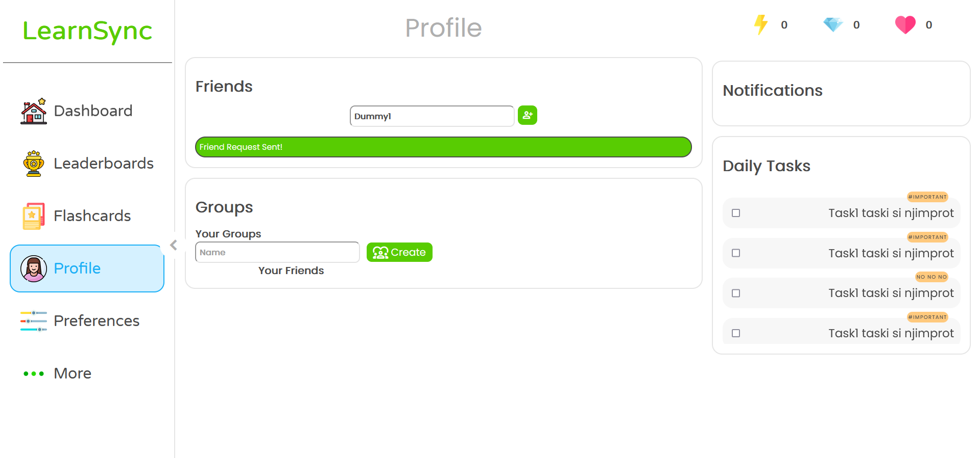
Implementation
Sending friend request

Slide 32
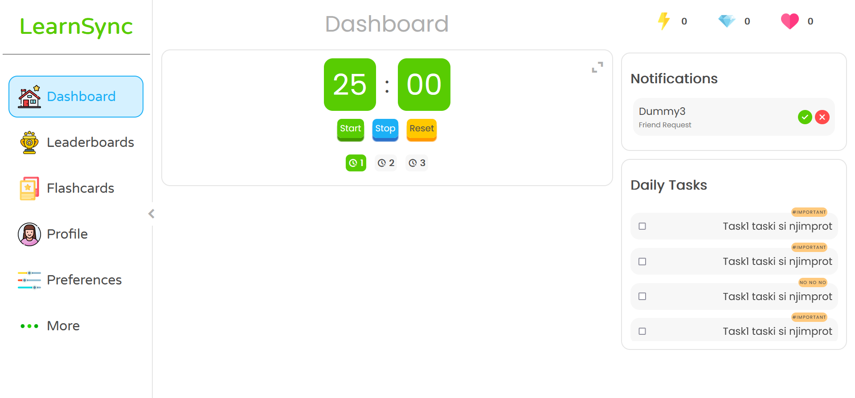
Implementation
Receiving request

Slide 33
Testing Plan
Scope of Testing : The testing plan covers functional, usability, security, and performance testing
Testing Objectives: The primary goals are defect identification, user satisfaction, and compliance with security and performance standards.
Testing Environment: Various OS, browsers, and network conditions are considered to guarantee broad compatibility.
Bug Tracking and Issue Reporting: A robust system, including tools like JIRA, tracks and manages issues efficiently.
Documentation and Reporting: Detailed test cases and reporting mechanisms are implemented to maintain clarity and provide reference for regression testing.

Slide 34
Test Result and Analysis
Authentication and User account management
Test ID | Test Condition | Expected Output | Actual Output | Remark
TC_001 | User fills in valid details for registration | Account successfully created | Account created message displayed | Pass
TC_002 | User enters valid login credentials | Successfully logged in | User redirected to the home page | Pass
TC_003 | User enters incorrect password during login | Display message indicating the wrong password | Proper error message shown | Pass
Pomodoro timer Functionality
Test ID | Test Condition | Expected Output | Actual Output | Remark
TC_004 | User clicks "Start" for Pomodoro timer | Timer starts counting down | Timer starts and displays countdown | Pass
TC_004.1 | User clicks "Stop" during active session | Timer pauses, displays remaining time | Timer pauses, remaining time visible | Pass
TC_004.2 | User clicks "Reset" during active session | Timer resets to initial state | Timer resets, values set back to starting point | Pass
TC_005.1 | User selects sequence i (25, 5, 25, 5, 25, 30) | Timer follows sequence accurately | Timer cycles through sequence correctly | Pass
TC_005.2 | User selects sequence ii (60, 10, 60, 10, 60, 30) | Timer follows sequence accurately | Timer cycles through sequence correctly | Pass
TC_005.3 | User selects sequence iii (75, 15, 45, 10, 30, 60) | Timer follows sequence accurately | Timer cycles through sequence correctly | Pass

Slide 35
Test Result and Analysis
Flashcard Functionality
Test ID | Test Condition | Expected Output | Actual Output | Remark
TC_006 | User creates flashcard with valid content | Flashcard successfully created | Flashcard added to collection | Pass
TC_007 | User navigates to flashcards section | List of created flashcards displayed | Flashcards shown with content | Pass
Social Features
Test ID | Test Condition | Expected Output | Actual Output | Remark
TC_008 | User sends friend request with valid name | Friend request sent successfully | Friend request status is pending | Pass
TC_009 | User receives and accepts friend request | Friendship confirmed, users connected | Friendship status changes to accepted | Pass
TC_010 | User creates a new group with a valid name | Group successfully created | Group added to user's group list | Pass
TC_011 | User adds tasks to a group, assigns labels | Tasks added to group with specified labels | Tasks visible in group with assigned labels | Pass
Task Management and Logout
Test ID | Test Condition | Expected Output | Actual Output | Remark
TC_012 | User creates tasks, labels as important/unimportant | Tasks created, labeled accordingly | Tasks visible with assigned labels | Pass
TC_013 | User clicks on "Logout" button | Successfully logged out, redirected to login page | User logged out, login page displayed | Pass

Slide 36
Conclusion
In conclusion, our thorough testing of LearnSync has confirmed the reliability and functionality of key features. The registration and login processes are seamless, ensuring a user-friendly onboarding experience. The Pomodoro Timer, with its start, stop, and reset capabilities, operates flawlessly, following specified sequences accurately. Users can create and view flashcards effortlessly, and social features like adding friends, group creation, and task management within groups have been validated for a smooth collaborative experience. Task creation, labeling, and the logout process all contribute to a well-rounded platform.

Slide 37
Future Scope
Looking ahead, we're excited to announce a forthcoming addition to LearnSync – the group function. This enhancement aims to elevate collaborative learning, allowing users to create and manage groups for a more interactive and engaging platform. The testing conducted so far lays a solid foundation, and we're committed to continuous improvement, ensuring LearnSync evolves to meet the dynamic needs of our users.

Slide 38

References
How to Study Effectively Article, Alexander Fowler et al. National Library of Medicine–
[“https://www.ncbi.nlm.nih.gov/pmc/articles/PMC5673147/#”]
Various Study techniques, their fieldwork, impact assessment of techniques on students of Med. School.
UI Design and Specification
[https://m3.material.io/]
Guidelines for designing, accessibility, components of UI for an elegant look to App.
Dopamine Nation: Finding Balance in the Age of Indulgence – Anna Lembke, American Psychiatrist
Learnt systematic application of techniques of learning to gain enhanced outcomes on users.
Research on “Snapchat Streaks: How Adolescents Metagame Gamification in Social Media” by Europe PMC - [“https://europepmc.org/article/ppr/ppr324038”]
Learning about effects of Streaks on motivating students.
Using Gamification in Education: A Systematic Literature Review, Research Gate Article – [“https://www.researchgate.net/publication/330093575_Using_Gamification_in_Education_A_Systematic_Literature_Review”]
Insights on impact of Gamification on aspirants/students scores and effects on learning quality of them.

Slide 39


